Slide 1
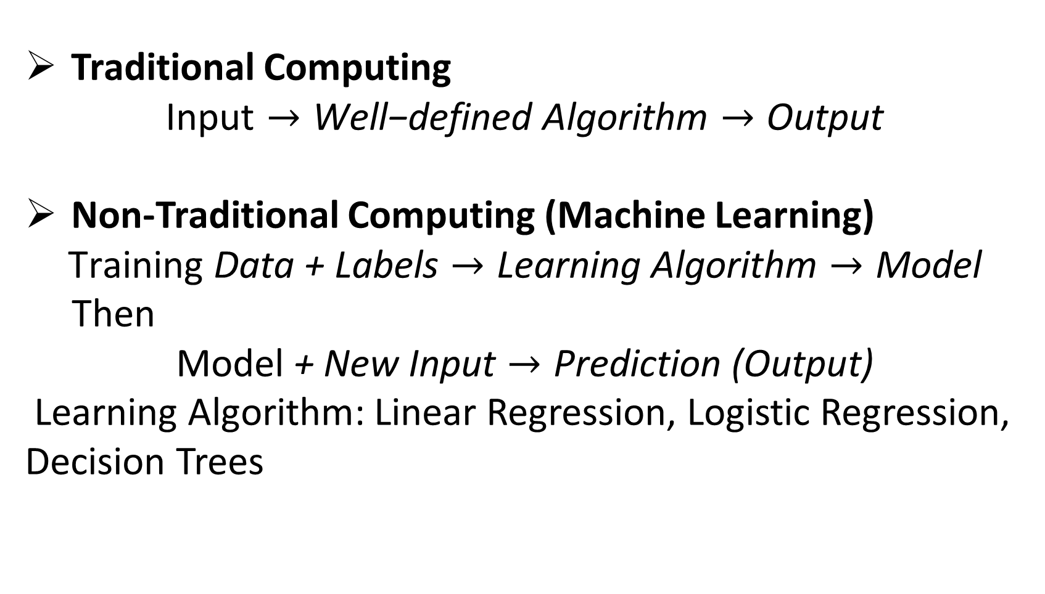
Computing
Traditional Computing
$$\text{Input}→\text{Well}\text{−}\text{defined} \text{Algorithm}→\text{Output}$$
Non-Traditional Computing (Machine Learning)
$$\text{Training} \text{Data}\text{ + }\text{Labels}→\text{Learning} \text{Algorithm}→\text{Model}$$
Then
$$\text{Model}\text{ + }\text{New} \text{Input}→\text{Prediction}\text{ (}\text{Output}\text{)}$$
Learning Algorithm: Linear Regression, Logistic Regression, Decision Trees

Slide 2
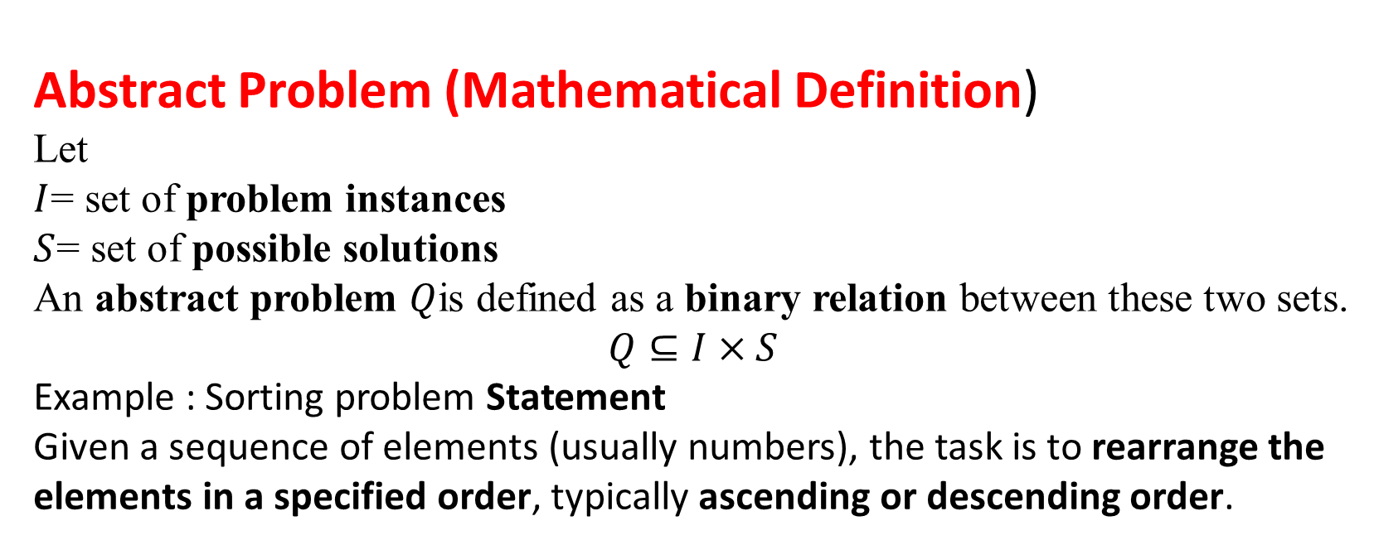
Interpretation of the Problem Definition
Abstract Problem (Mathematical Definition)
Let
$I$= set of problem instances
$S$= set of possible solutions
An abstract problem $Q$is defined as a binary relation between these two sets.
$$Q⊆I×S$$
Example : Sorting problem Statement
Given a sequence of elements (usually numbers), the task is to rearrange the elements in a specified order, typically ascending or descending order.

Slide 3
Steps Involved in Solving a Problem
1. Understanding the problem
2. Identify suitable data structures(A data structure is a method of organizing, storing, and managing data in a computer so that it can be accessed, processed, and modified efficiently)
Array : An array is a linear data structure that stores a collection of elements of the same data type in contiguous memory locations, where each element is accessed using an index.
Stack : A stack is a linear data structure in which elements are inserted and removed according to the Last In First Out (LIFO) principle. The last element added to the stack is the first element to be removed.
Queue : A queue is a linear data structure in which elements are inserted at the rear and removed from the front, following the First In First Out (FIFO) principle.
Linked List : A linked list is a linear data structure consisting of a sequence of nodes, where each node contains data and a pointer (link) to the next node in the list.

Slide 4
Steps Involved in Solving a Problem
3. Develop the logic
4. Convert logic into an algorithm(An algorithm is a finite sequence of well-defined steps used to solve a problem or perform a specific task.)
5. Analyze time complexity(Time complexity of an algorithm is the number of computational steps (operations) it takes to complete, expressed as a function of the input size.)
6. Prove correctness of the algorithm.
Example : Real-World Problem: How to Cook Boiled Rice
Example : Sorting problem Statement
Given a sequence of elements (usually numbers), the task is to rearrange the elements in a specified order, typically ascending or descending order.

Slide 5
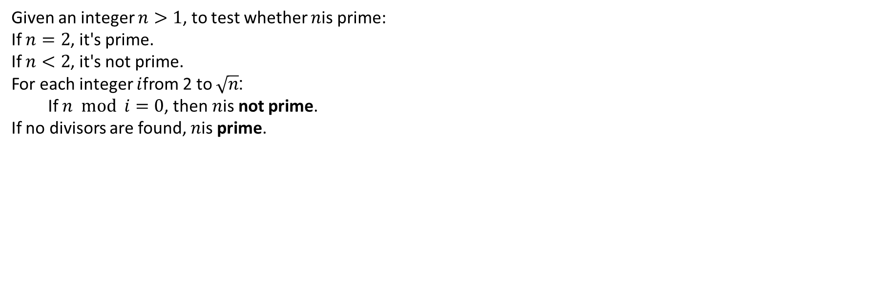
Naive Trial Division Algorithm for Primality Test
Given an integer $n>1$, to test whether $n$is prime:
If $n=2$, it's prime.
If $n<2$, it's not prime.
For each integer $i$from 2 to $\sqrt{n}$:
If $n mod i=0$, then $n$is not prime.
If no divisors are found, $n$is prime.

Slide 6
Time complexity
LinearSearch(A, n, key) for i = 1 to n if A[i] == key return i return -1
Algorithm()
for i = 1 to n-1 for j = 1 to n-i if A[j] > A[j+1] swap(A[j], A[j+1])

Slide 7
Time complexity
BinarySearch(A, low, high, key) while low ≤ high mid = (low + high)/2 if A[mid] == key return mid else if key < A[mid] high = mid - 1 else low = mid + 1

Slide 8
Time complexity
for i = 1 to n for j = 1 to n for k = 1 to n C[i][j] += A[i][k] * B[k][j]

